Slide 1
Towards a South African Open Science Cloud SAOSC: a sustainable and federated infrastructure model
Dr Dale Peters, ZA.NREN, 20 September 2023

Slide 2
The Dialogue Process
SA-EU Dialogue Facility supports political dialogue and cooperation in bilateral matters between the SA Government and the European Union.
Two policy dialogues on Open Science hosted by the Department of Science and Innovation conducted with the aim of strengthening science diplomacy between South Africa and the European Union.
The most recent project conducted from 2021-2022 informs the development of a South African Open Science Cloud (SAOSC) to provide the research community with a federated and open multi-disciplinary computational environment where they can find and reuse data, tools and services for collaborative research and innovation.
Notes:
This SA- EU Dialogue Facility initiative builds upon previous key initiatives, viz. the South African Research Infrastructure Roadmap (SARIR) framework, developed in 2016 as the basis for prioritising the development of national research infrastructure needs. An Open Science dialogue conducted in 2017-2018 sought to inform the development of a set of Open Science principles, guidelines, and recommendations in the form of a policy framework relevant to the South African context.
South African Research Infrastructure Roadmap (2016). Pretoria: Department of Science and Technology. ISBN: 978-0-621-44974-7. https://www.gov.za/sites/default/files/gcis_document/201610/sa-research-infrastructure-road-mapa.pdf
SA-EU Open Science Dialogue, Hodson, Simon, Walwyn, David, Wood, John, & Wright, Colin. (2019). SA-EU Open Science Dialogue Report. Zenodo. https://doi.org/10.5281/zenodo.2559469

Slide 3
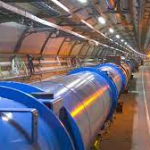
Why SAOSC?
Scientists increasingly seek to execute computational research processes on cloud-based infrastructure resources that provide the tools and services designed to meet the needs of their scientific domain, irrespective of geographic location.
Many South African researchers have identified such resources internationally, and are making use of them under personal agreements
Notes:
Scientists increasingly seek to execute computational research processes on cloud-based infrastructure resources that provide the tools and services designed to meet the needs of their scientific domain, irrespective of geographic location. Reliant on robust existing research networks, many South African researchers have identified such resources, and are making use of them under personal agreements.

Slide 4
Context
International Open Science Cloud initiatives are evolving
Increasing Open Science mandates
Responsible research, social impact, innovation
Aggregation of tools and services to meet needs of scientific disciplines
Provide guidance in principles and practices of international collaboration
Develop national Open Science Cloud policy
Notes:
Development of international Open Science Cloud initiatives to promote alignment and interoperability between shared infrastructures, to empower global and equitable research collaboration.
Open Science mandates by research funding agencies internationally, as well as the South African government, are aimed at improving the efficiency of the research ecosystem and accelerating research outcomes.
Such mandates promote the broadening of research impact assessment to demonstrate ethics of responsible research, increased social responsiveness, innovation, and citizen engagement.
Scientists increasingly seek to execute computational research processes on cloud-based infrastructure resources that provide the tools and services designed to meet the needs of their specific domain, irrespective of geographic location.
This dialogue seeks to provide guidance in the principles and practices of engaging in such international collaboration

Slide 5
SAOSC Value Proposition
Embark upon a process to create a South African Open Science Cloud that requires engagement, coordination, and support from all stakeholders at national and institutional level
Bring together stakeholders across the research ecosystem, including research funders, research performing organisations, service providers, and intermediary bodies
Address technical, policy, and organisational issues in an initial pilot; long-term focus on human- centric research support, advocacy and change management in the adoption of evolutionary Open Science practice
Notes:
Based on the premise that data held in South African repositories has significant impact on diverse areas of human development, with potential for exponentially increased impact if shared and reused by the research community, the SAOSC Dialogue examined the practices and risks of engagement in international collaboration.

Slide 6
Initial Outcomes
Recommendations for a SA Open Science Cloud (SAOSC) Policy Framework directed towards the DSI
Principles and guidelines for the stakeholder community to pledge support for the implementation of the South African Open Science Cloud (SAOSC), presented in the SAOSC Declaration
Define a Roadmap for deeper Open Science collaboration between EU and SA cloud initiatives
Notes:
Recommendations were made for support actions and services that enable South African researchers to access resources and contribute to global solutions, in the assurance of mutual benefit, and in alignment with the concurrent development of a national open science policy for South Africa.

Slide 7
Recommendations: Technical Implementation
Prof Russ Taylor
Notes:
RT

Slide 8
SOASC will be a Federation of Clouds
Distributed federation of scientific data infrastructures, research infrastructures and e-infrastructures
Single sign-on Authentication
Role-based Authorization to allow self management of project teams for accessing resources
Trusted repositories and catalogues of containers, VMs, notebooks, data sources, …
Data access and WAN transfer tools

Slide 9
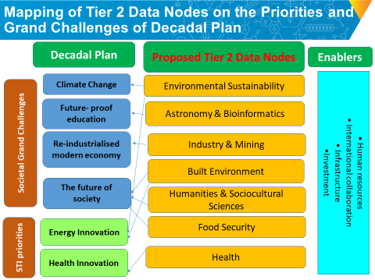
Identify Science Domains for pilot development
Data intensive science domains that drive SAOSC technical requirements
National research infrastructure roadmap priorities (SARIR)
Co-investment opportunities
From Draft SA Decadal Plan for Science, Technology and Innovation

Slide 10
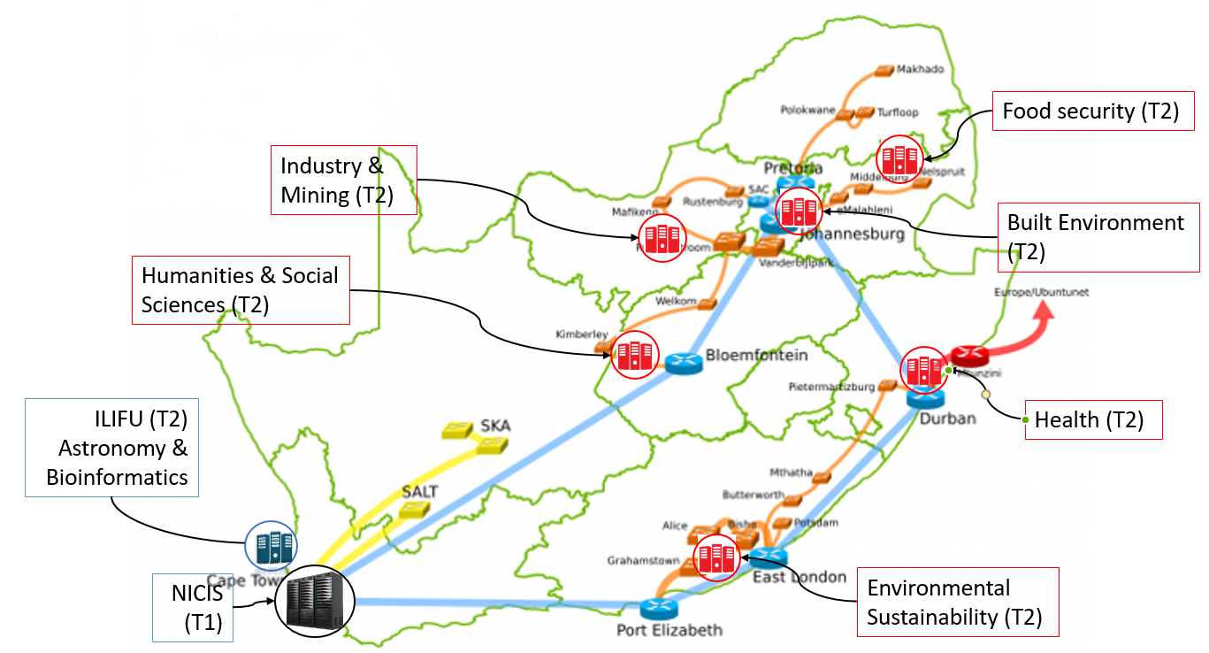
Federated cloud of NICIS Tiered Infrastructure
Federate existing Tier-2 (SARIR, ilifu) and Tier-1 (NICIS) cloud
Progressively establish additional Tier-2 demonstrators
Co-investment
DSI & regional institutions/stakeholders
Concept Framework for establishing Region Tier-2 Data Nodes as an Extension of NICIS
Anwar Vahed, DSI, CSIR

Slide 11
National Authentication and Authorization Service
Single sign-on for SAOSC environment
South African Identity Federation
Provided as national service by TENET
Recognized by other national identify providers to facilitate interoperability with global open science clouds and federation with EOSC
Authorization
Service of the federated cloud
Role-based allowing group self management of projects
Project allocations managed by Resource Providers

Slide 12
Shared repositories and catalogues of trusted software and services
National (DIRISA Tier 1) repository (Market Place) of data and service for long-term curation and open science access
Authorized access to shared software (containers) and services
platforms, software, infra-structure
Domain specific software and services repositories may reside at Tier 2 level

Slide 13
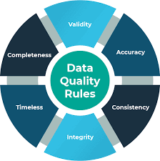
Recommendations: Data Quality
Dr Dale Peters
Notes:
DP

Slide 14
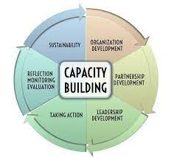
Capacity Building
Enable all researchers and stakeholders to actively participate in national and international collaborative research projects that further the development of SAOSC.
Formalise a sustainable entity with the mandate to participate in national and international collaborative research and R&D projects.
Focus on capacity building of RI management and research support staff -
not supported elsewhere.

Slide 15
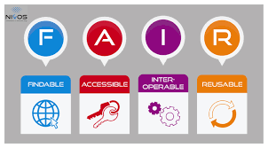
Stimulate FAIR data in the development of two new but separate career paths
Data science – the ability to handle, process and analyse data to draw insights from it – scientists and postgrad students.
Data stewardship – the skills to ensure data are
properly managed, shared and preserved,
both throughout the research lifecycle and for
long-term preservation – librarians, designated
research project staff, and postgrad students
Turning FAIR into reality. (2018) https://ec.europa.eu/info/sites/default/files/turning_fair_into_reality_1.pdf

Slide 16
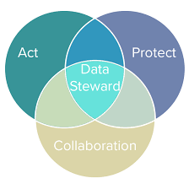
Data Stewardship in change management
Create a national network of data management experts to support
a new way of thinking about OS research practice
Strengthen the curatorial role of research libraries by providing expertise and resources to facilitate the development of data stewardship knowledge within disciplines.
Provide incentives and acknowledgment of the data stewardship role in driving Open Science practice
Promote institutional structures to revise research impact assessment, academic accreditation ratings and promotion systems to reward RDM, FAIR and Open Science practices for societal and knowledge impact
NRF Framework to Advance the Societal and Knowledge Impact of Research (2020). https://www.nrf.ac.za/wp-content/uploads/2021/12/NRF-Framework-to-Advance-the-Societal-and-Knowledge-Impact-of-Research.pdf
Notes:
Drive innovation in line with the NRF Framework to Advance the Societal and Knowledge Impact of Research.

Slide 17
Recommendations: Sustainability
Prof Jean-Claude Burgelman
Notes:
JCB

Slide 18
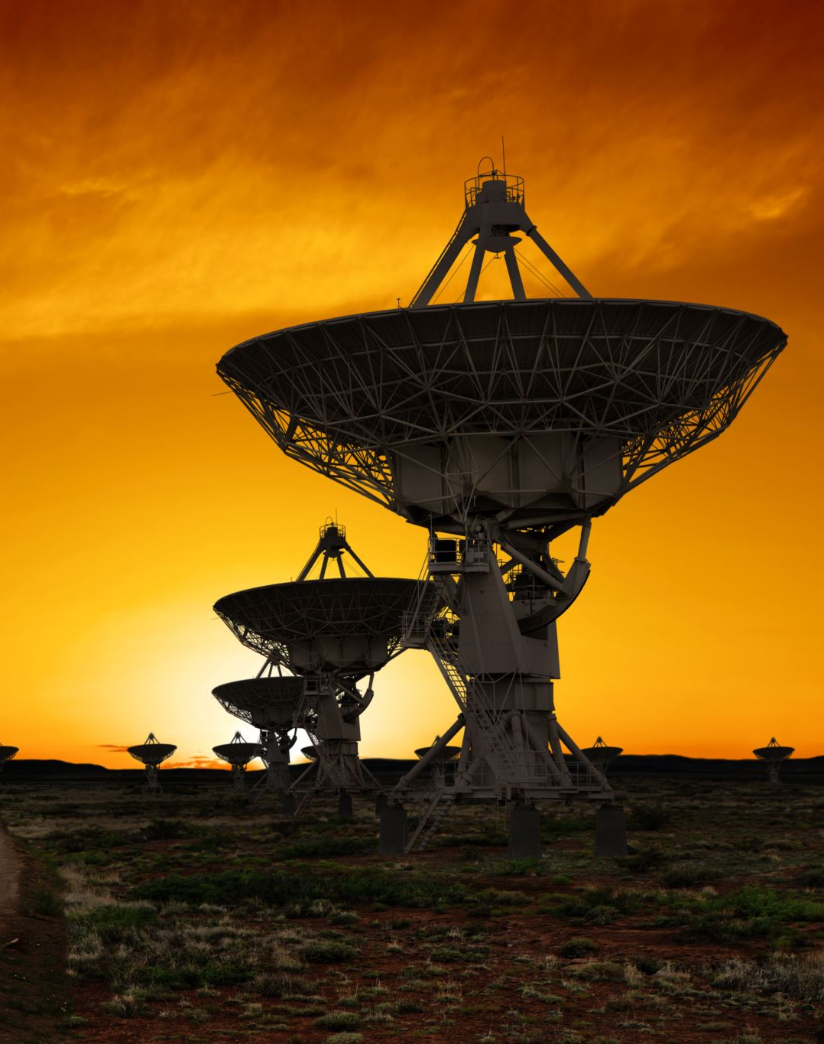
All Open Science clouds are international and SAOSC must be on par with international standards. This implies active participation in the relevant international fora.
Finance the Open Science Cloud in SA as a stand- alone open data infrastructure with a service-oriented mission to support researchers.
Lead robust social change and transformation in research practice and political engineering.
Notes:
JCB

Slide 19
Recommendations: Governance
Dr Valentino Cavalli
Notes:
VC

Slide 20
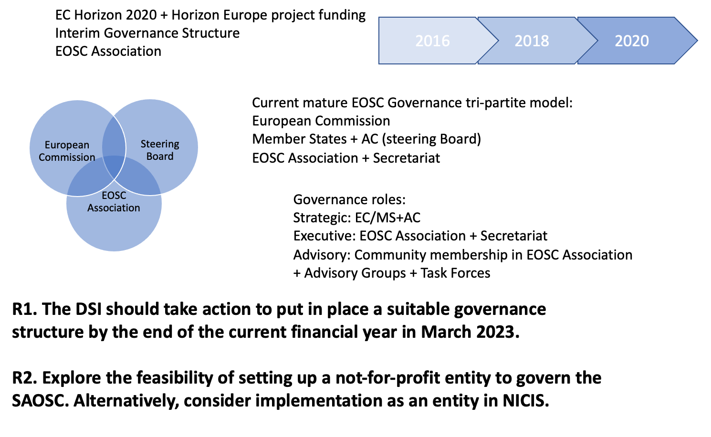
Notes:
Create a local entity equivalent to the EOSC Association model, funded by the EU.

Slide 21
SAOSC Declaration
Buy-in and non-binding commitment of key stakeholders to establish the SAOSC as a user-driven research support service
Signatories endorse the intents and will actively support their implementation through the establishment of communities of practices and by serving as champions in promoting the process at institutional level
Form voluntary task groups and advisory groups to provide input on policy development, governance, technical interoperability, data quality standards, user engagement, financial sustainability, and other rules of participation
Notes:
Secure the buy-in and commitment of support of the research community

Slide 22
Preliminary Roadmap
Governance
Funding
Implementation
Technical issues
Change management
Notes:
Initial cloud infrastructures, such as the SKA, ILIFU and SARIR projects provide the means to address immediate technical, policy and organisational issues with a long-term focus on human-centric research support, advocacy and change management in the adoption of evolutionary open science practice.
List of priorities suggested to the DSI.

Slide 23
You can make SAOSC happen
Sign the Declaration and become champions of SAOSC
Participate in task teams and advisory groups
Direct capacity development towards emerging technologies
Support trusted repositories, catalogues of services, and research support services and software engineers
Contribute to joint research proposals that enable both science and R&D into cloud services

Slide 24
Towards a South African Open Science Cloud SAOSC: a sustainable and federated infrastructure model
Questions?

